Slide 1
SC Demo
Applications Step-by-Step

Slide 2
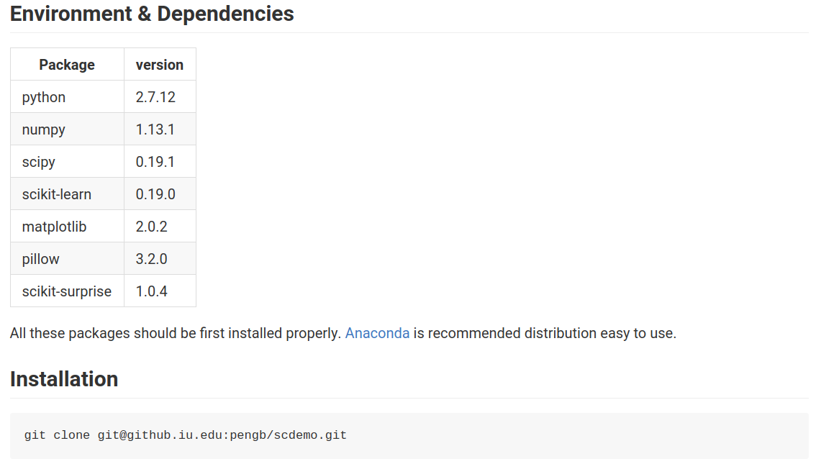
Prerequisite & Installation
dasdfasd
For more details, refer to: https://github.iu.edu/pengb/scdemo/tutorial

Slide 3
Run Image Clustering
Commandline
This script run image clustering application on the 15scene(Fifteen Scene Categories) dataset.
There are two output files:
draw plot of clusters on 2D dimension, save as kmeans_2d.png
draw samples of the result clusters, save as random.pdf with each line a cluster
$ cd scdemo/test
$ ../bin/run_kmeans.sh

Slide 4

Screen Output
cluster number
input dataset properties, sample and feature number
the execution time of kmeans
a group of metric to evaluate the performance of clustering, including homo, compl, v-meas, etc. The bigger of the value the better.

Slide 5
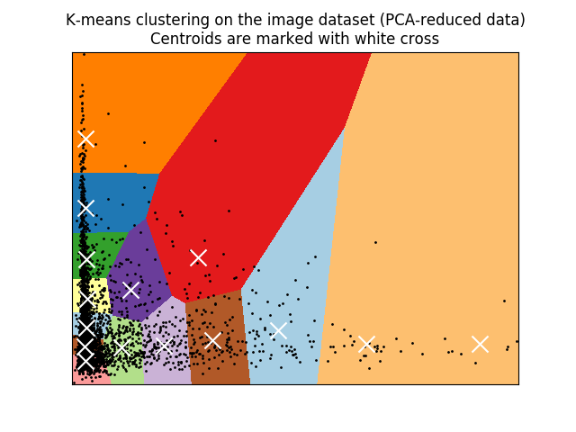
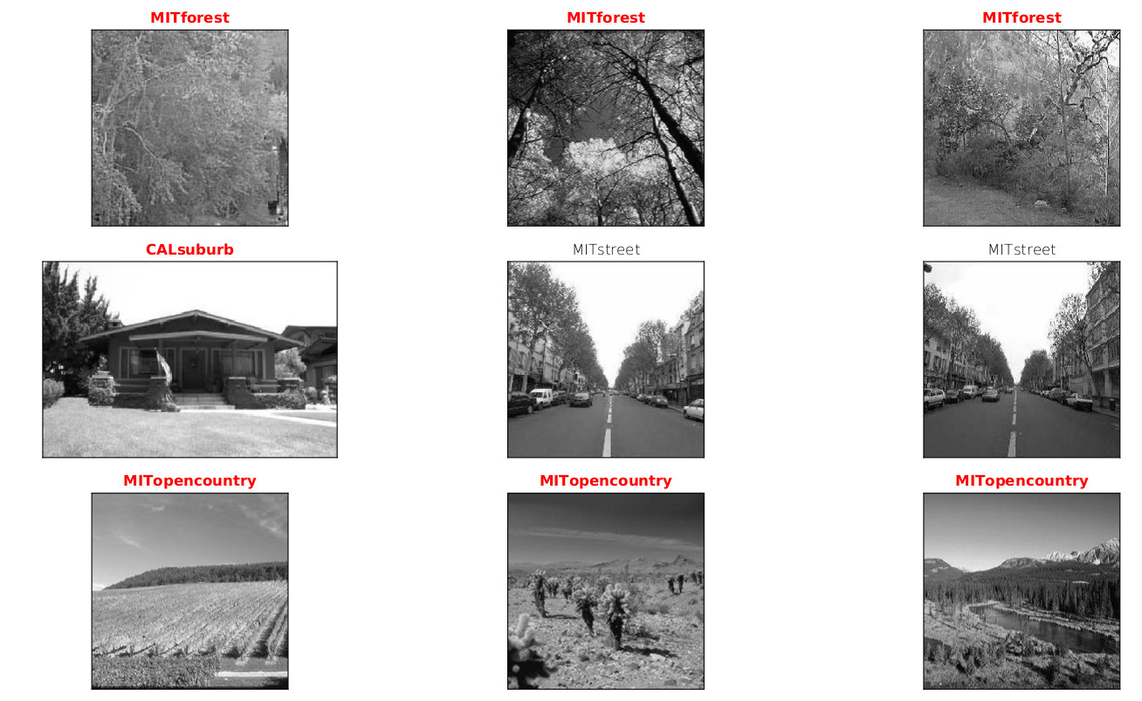
Final Results
kmeans_2d.png
random.pdf: sample images of the result clusters, one row for each cluster

Slide 6
TODO List
Current image clustering passed the test with harpdaal kmeans call manually.
Wait for BoFeng to replace current mock code with harpdaal pytho interface.

